Slide 1
Introduction
The basic idea of this project is, the use of an ultrasonic sensor along with a Smartphone to aid the person suffering from being visually disable. The proposed model Incorporates of a hand glove strapped around the user's wrist, fitted with an Ultrasonic Sensor, Microcontroller, a Bluetooth Module and, a vibration motor. This system is not only reliable completely but also provides cost-efficient guidance for visually disabled person. Our system is being designed to experiment a wide amount of area using an ultrasonic sensor and a camera of a Smartphone. You are provided with a vast range and a decent speed in the detection of an obstacle. When an obstacle is near, the processor is immediately alerted and the path is conveyed to the visually impaired using tactile system

Slide 2
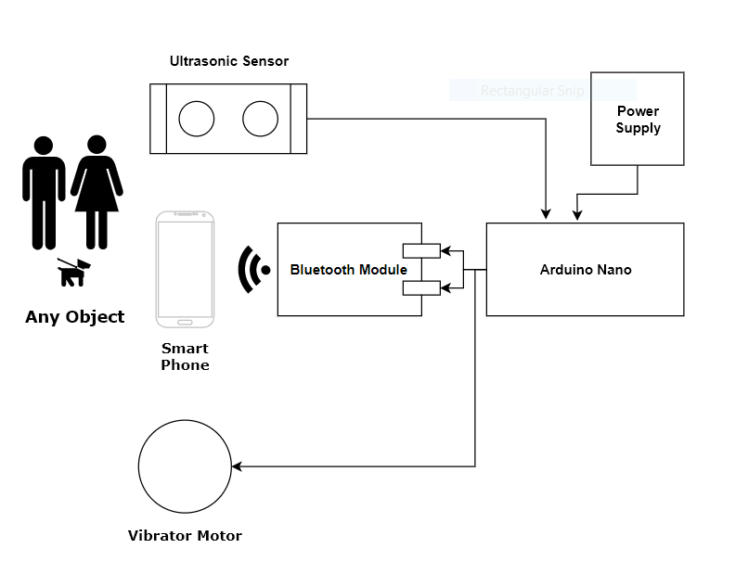
IMPLEMENTATION
Block Diagram

Slide 3
IMPLEMENTATION
Components Used(Hardware)
Sr. No | Name of Component | Specification
1 | Arduino NANO | ATmega328,14 Digital,8 Analog
2 | Ultrasonic Sensor | 5V DC, 0.02 – 4M, <2mA
3 | Gloves | Leather
4 | Coin Vibrator | 3V, 70mA
5 | Connecting Wires | -
6 | Bluetooth Module(HC- 05) | 6 Pin, 3 - 6V
7 | Power Bank | 5V, 2 A, 2000mAh

Slide 4
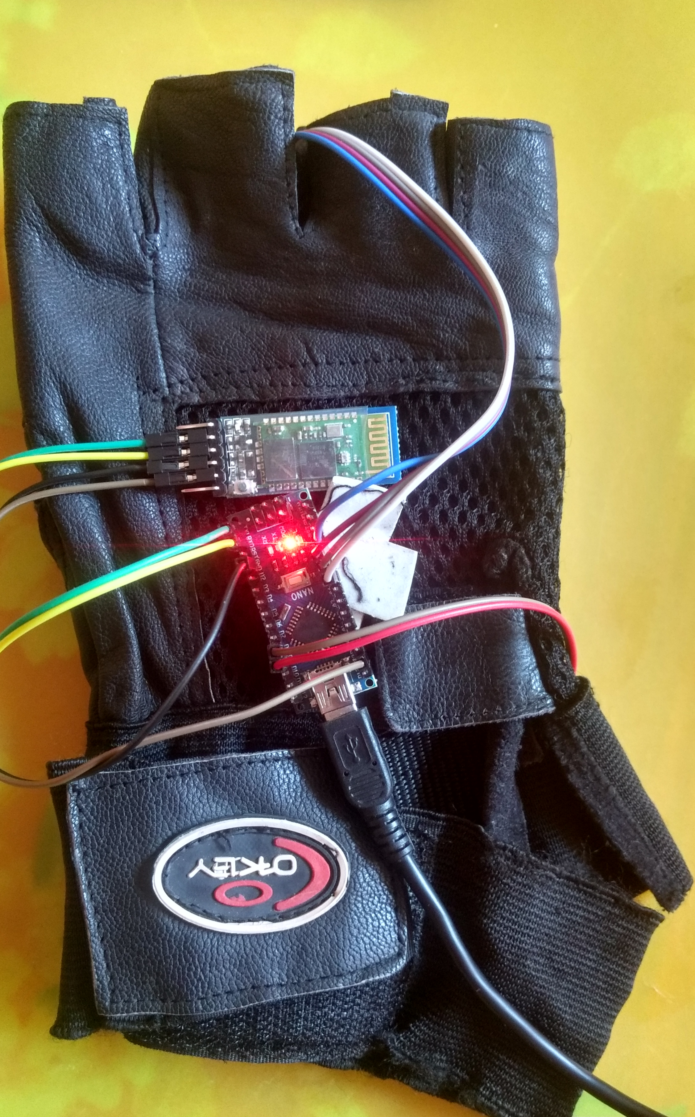
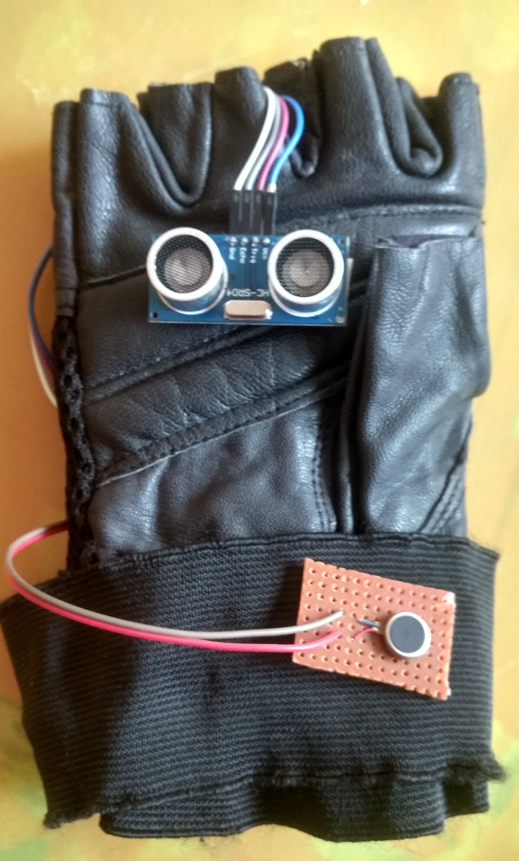
IMPLEMENTATION

Slide 5
IMPLEMENTATION
Components Used(Software)
Arduino IDE
Android Studio
Python (TensorFlow Object detection library)

Slide 6
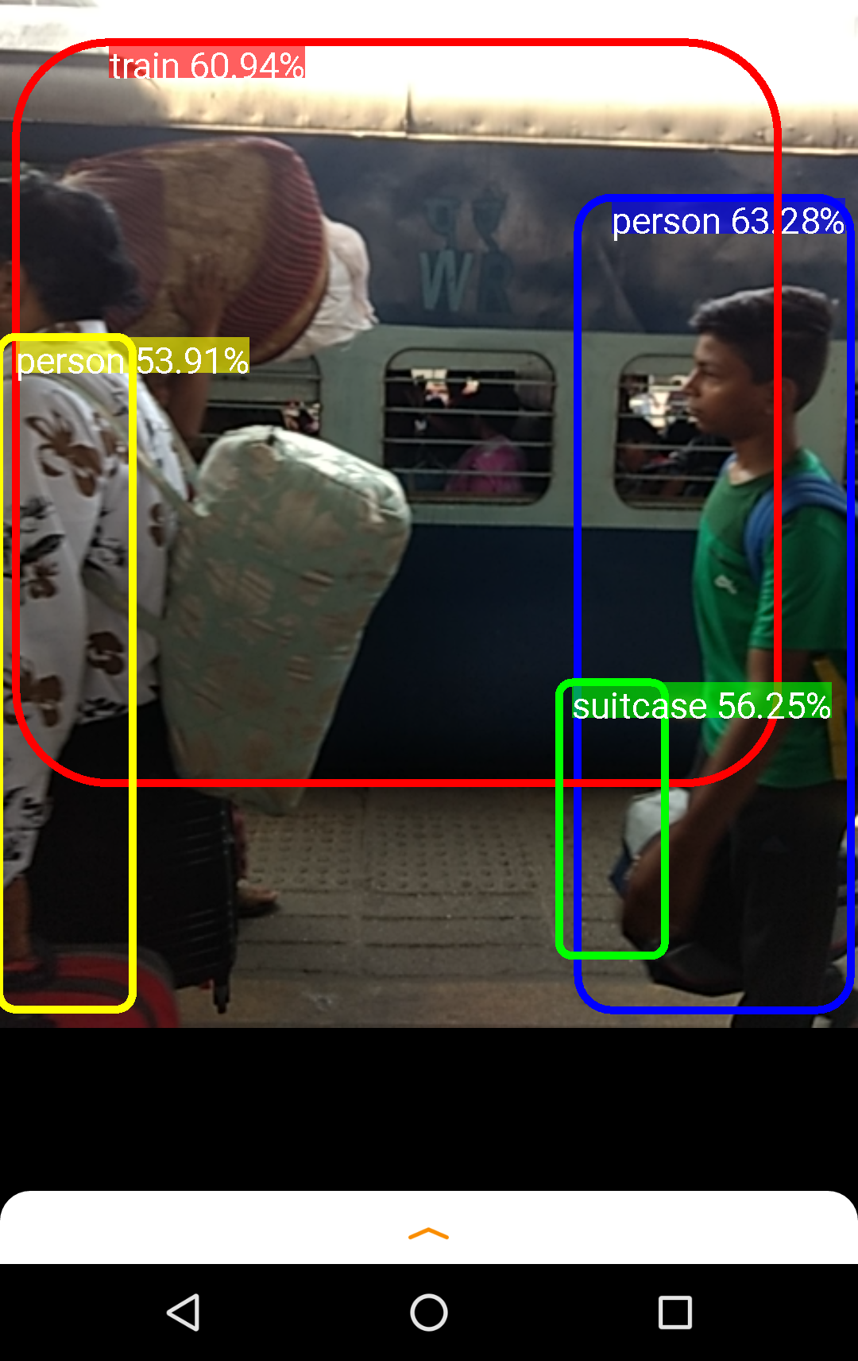
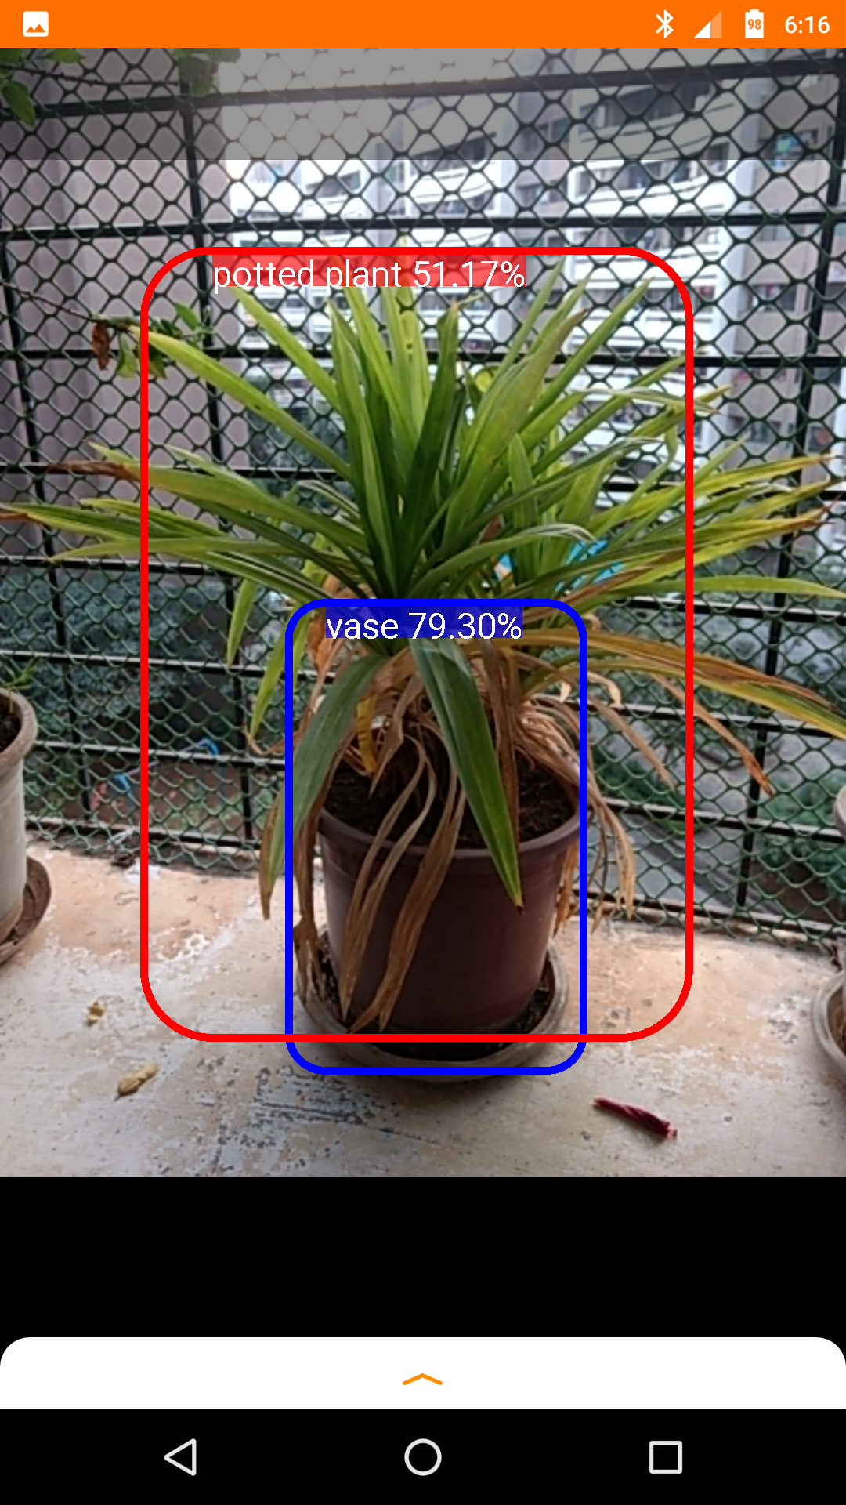
IMPLEMENTATION
Software testing

Slide 7
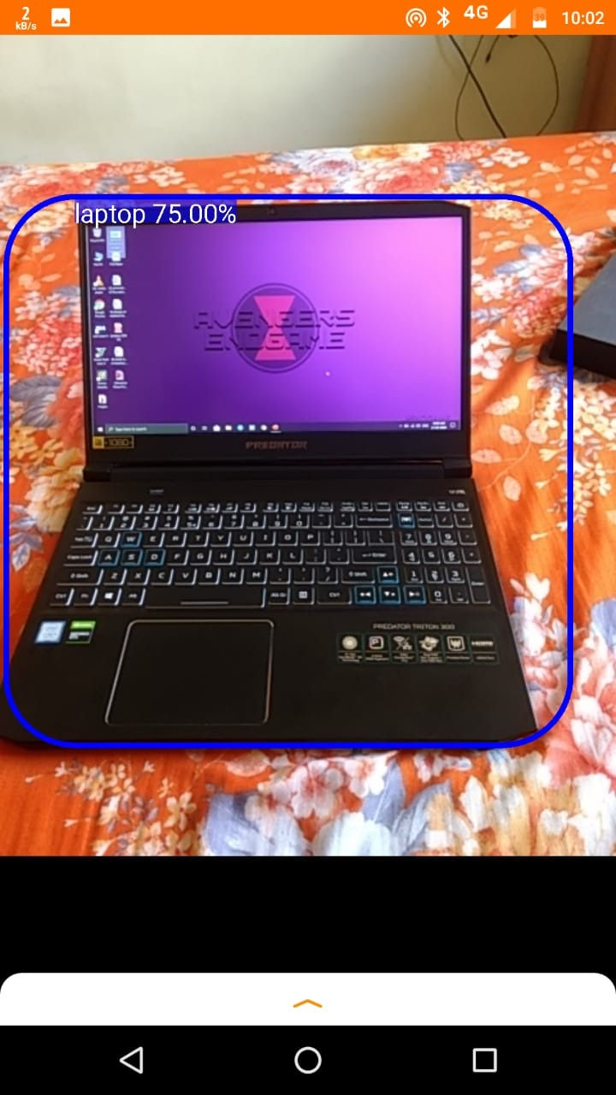
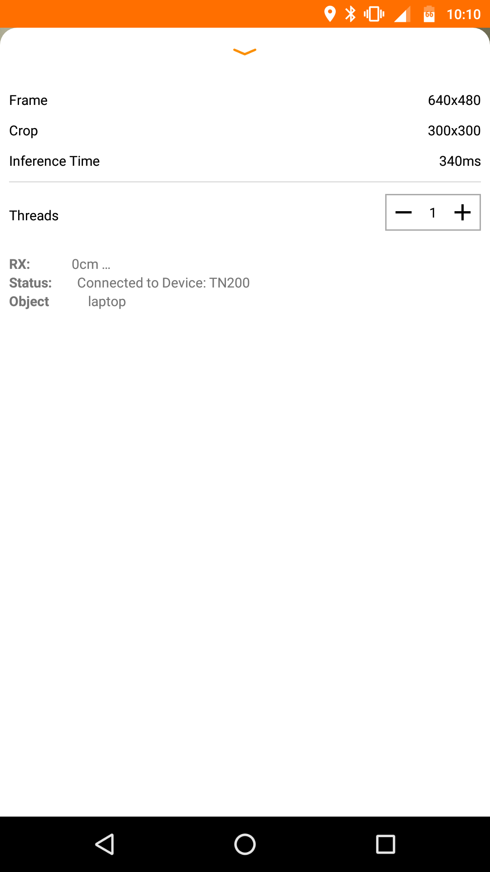
IMPLEMENTATION

Slide 8
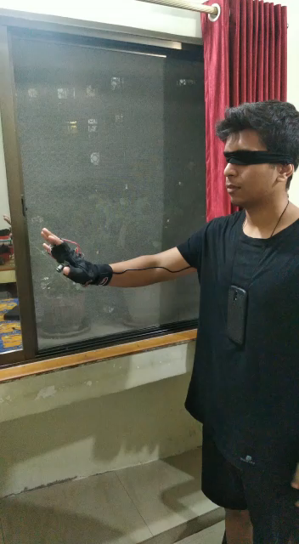
Testing

Slide 9
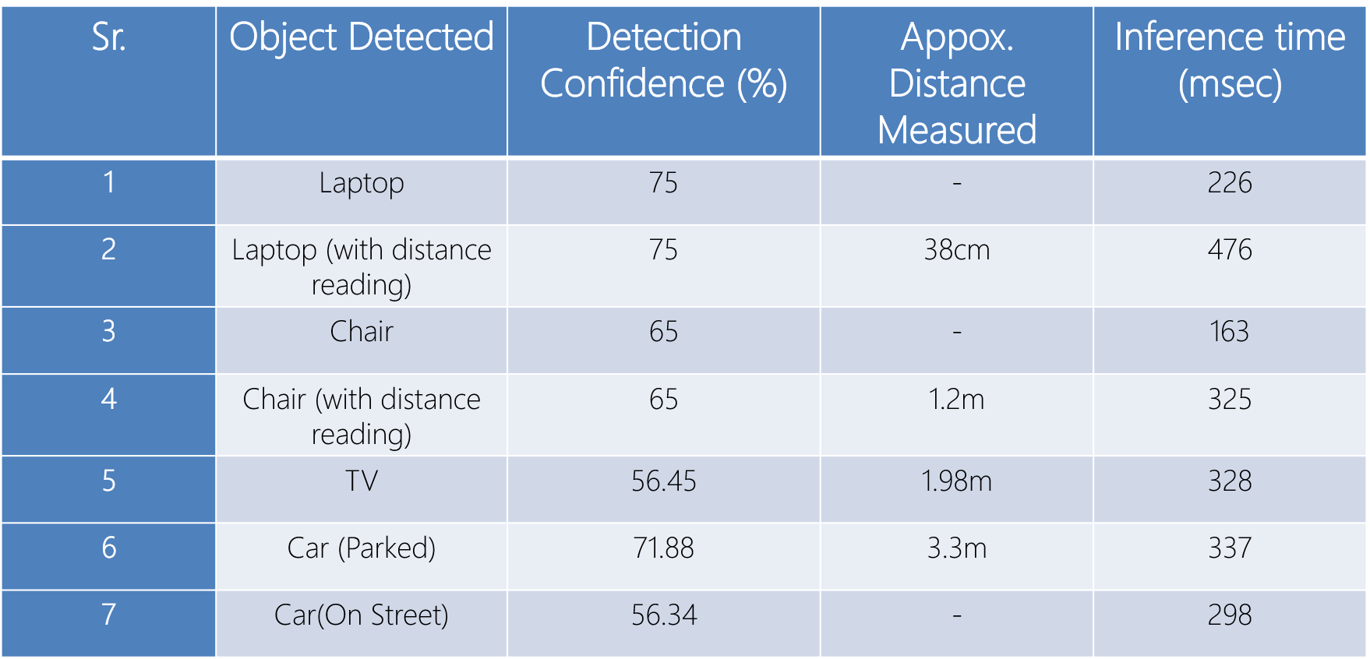
Result

Slide 10
Conclusion
With the implementation of the device described, the aim is to assist the visually impaired by acting as a visual substitution device with the prime objective to make aware of the object in front of the user.

